Slide 1



Thin Films for Quantum Networking: Effect of P-type Doping on Spin Coated ITO Thin Films
Selena Lamborn, Madison King,
Henry Garland and Dr. Stephanie Hurst

Slide 2
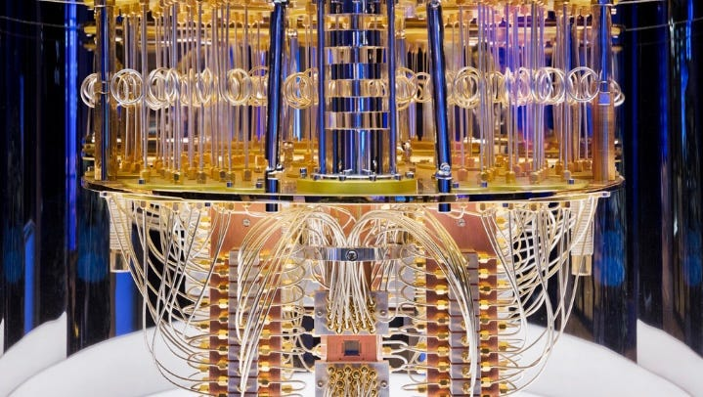
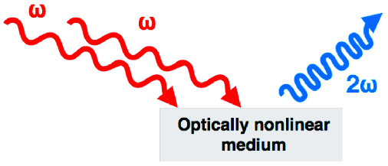
Introduction
Transparent conductive oxides (TCO's)
Indium Tin Oxide (ITO)
Spin coating
Epsilon-near-zero^{2,5}
Frequency Switching
Superconducting ITO³
Medium.com¹
2
Motasco et. al⁴

Slide 3
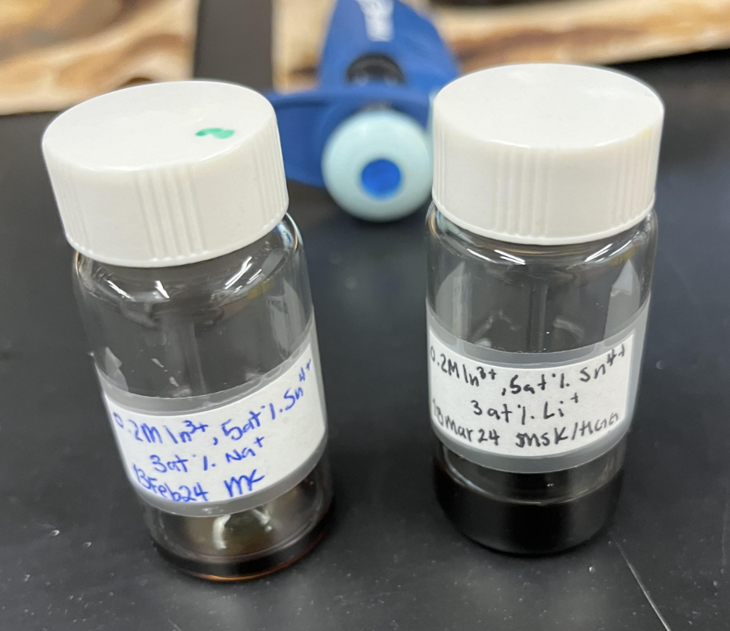
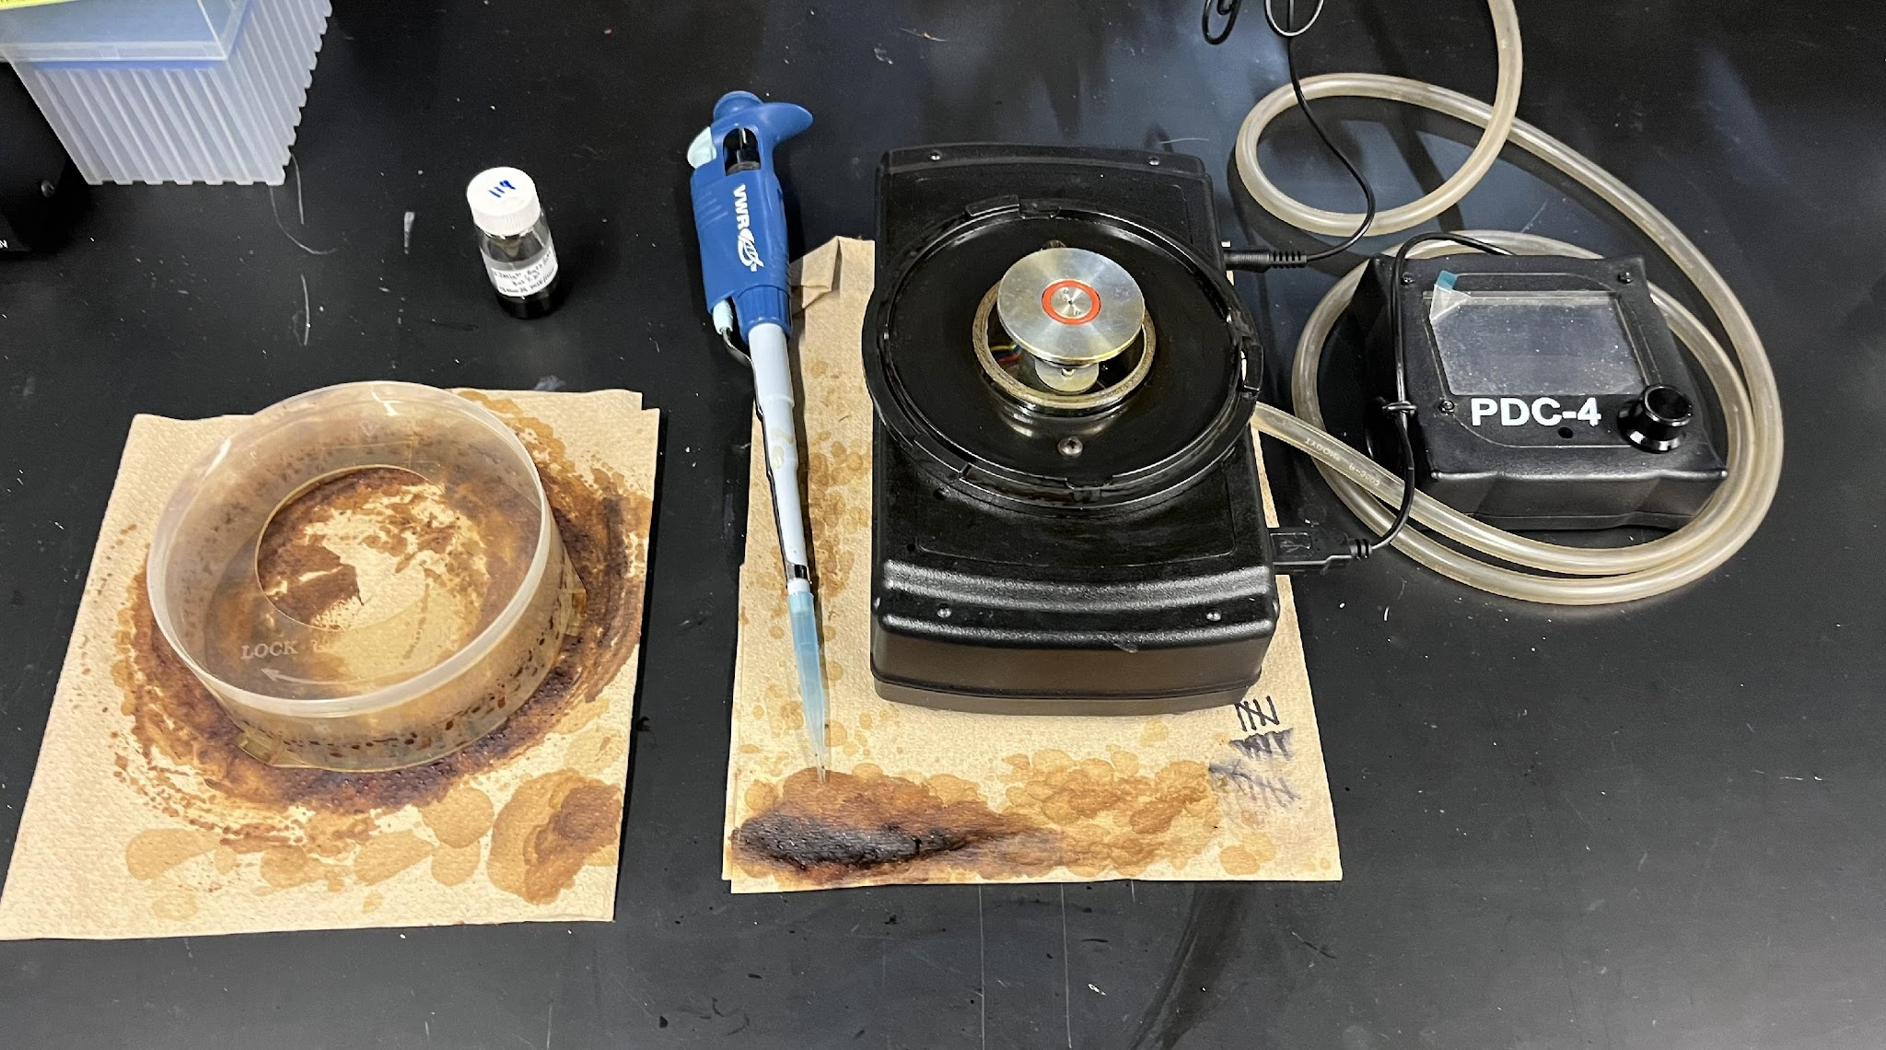
Methods - Slide Creation
Make ITO solution
3 atom% Na⁺, Li⁺, K⁺
0.2 M In³⁺
5 atom% Sn⁴⁺
Glass substrate
Spin coat slides
200 μL of solution
1500 rpm increased to 2000 rpm and spin for 60 seconds
125 ºC then 400 ºC drying step
150 ºC H₂/Ar annealing step
Lamborn, S. 2024
Lamborn, S. 2024
3

Slide 4
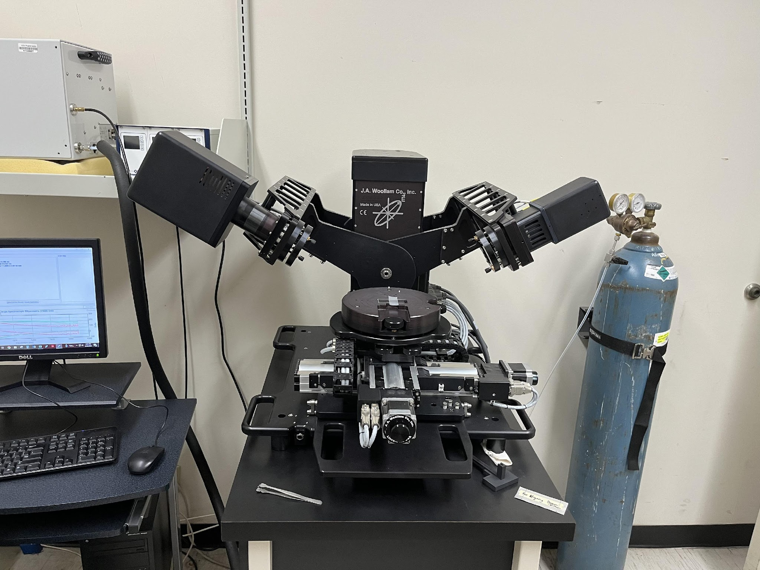
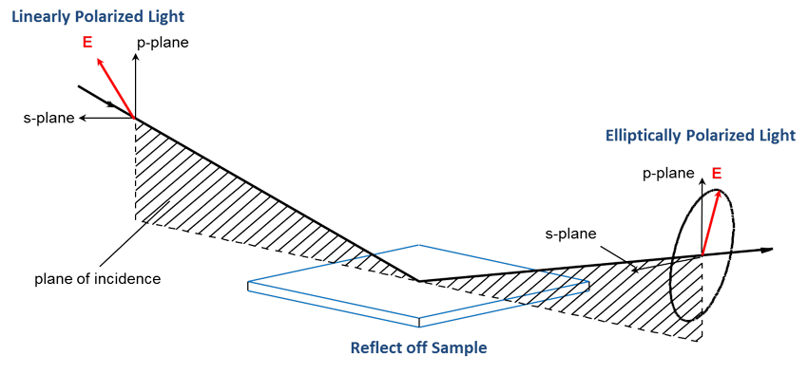
Methods - Slide Characterization
UV-Vis
Optical transparency
Optical bandgap
Ellipsometry
Refractive index: n
Permittivity: ε, ε'
Extinction coefficient: k
Lamborn, S. 2024
4
J.A. Woolam⁶

Slide 5
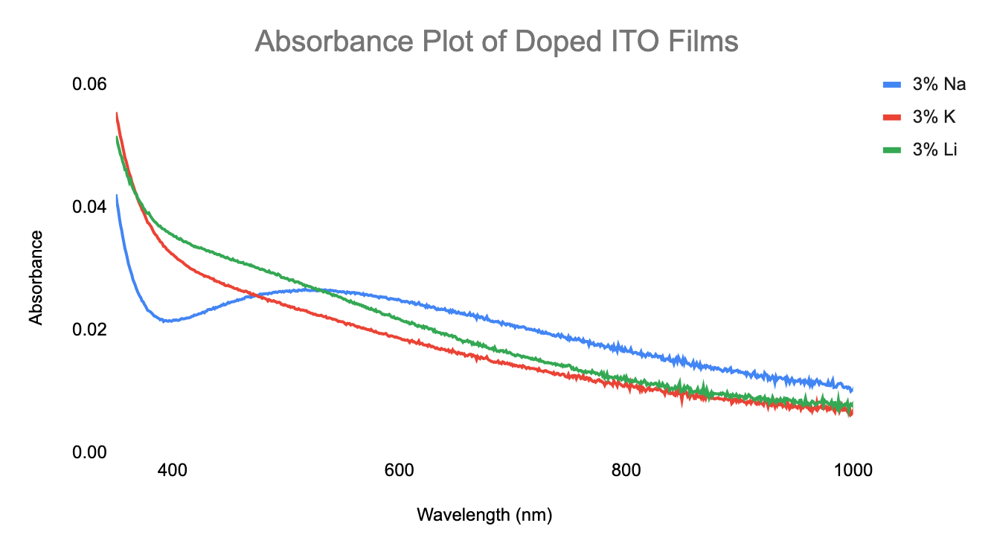
Results and Discussion - UV-Vis
3% Na⁺
Highest absorption in the visible, lowest in the UV
3% K⁺
Lowest absorption in the visible, higher in UV than Na⁺
3% Li⁺
Higher absorption than K⁺ in the visible, lower than Na⁺ in the UV
Lamborn, S. 2024
5

Slide 6
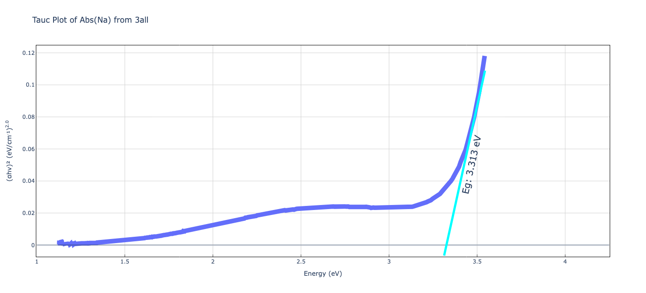
Results and Discussion- Tauc Plots
Lowest energy photon absorbed to excite electrons
Smaller bandgap = lower optical transparency
Na⁺ Tauc plot feature at 2.5 eV, not present in other plots
Dopant Species | Experimental Bandgap Energy (eV)
3 at% Li⁺ | 3.15
3 at% Na⁺ | 3.31
3 at% K⁺ | 3.19
Lamborn, S. 2024
6

Slide 7
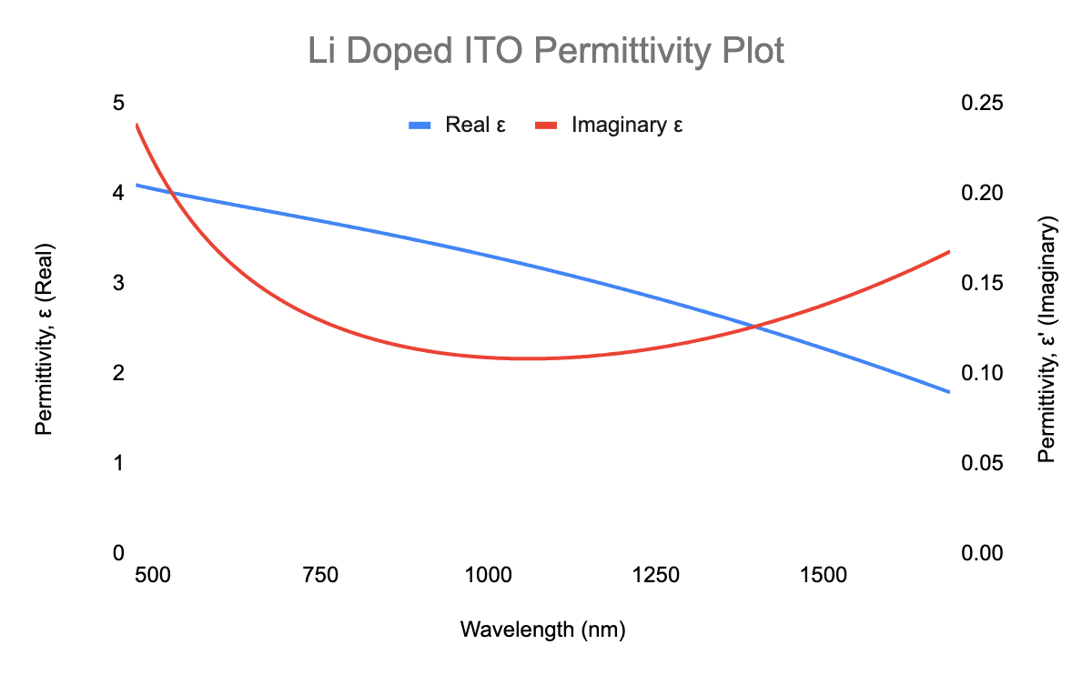
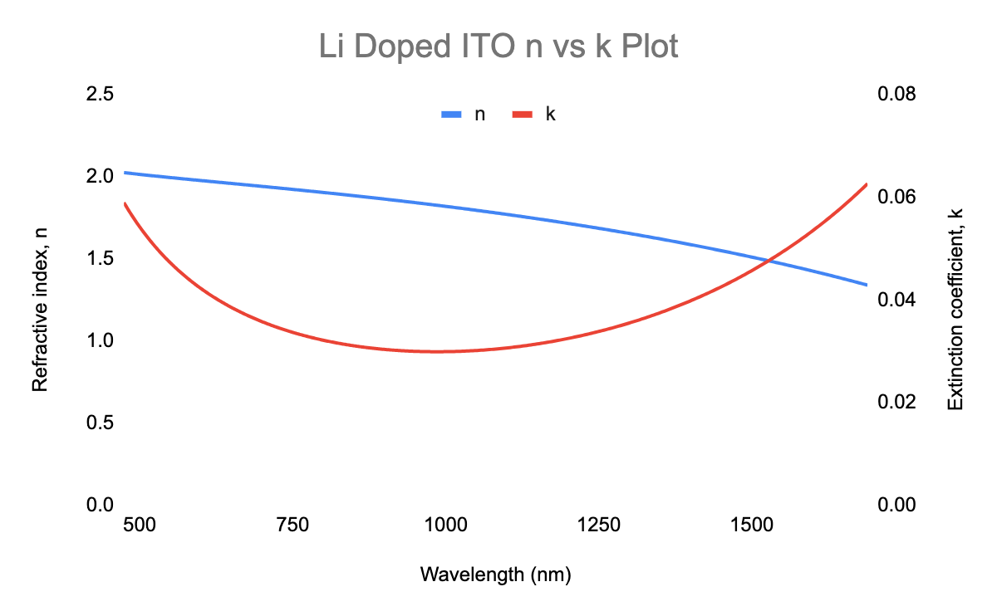
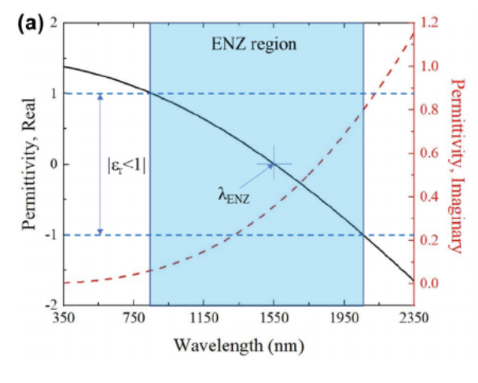
Results and Discussion - Ellipsometry
Refractive index, n
Extinction coefficient, k
Permittivity: ε, ε'
Lamborn, S. 2024
7
Lamborn, S. 2024
Kuen Yao et. al²

Slide 8
Conclusion
Transparent in visible and IR
Refractive index changes
ENZ region not observed at desired wavelength, but making progress
Continue to tune dopant type and levels
Examine electrical properties of doped ITO thin-films
Lamborn, S. 2024
Medium.com¹
8

Slide 9

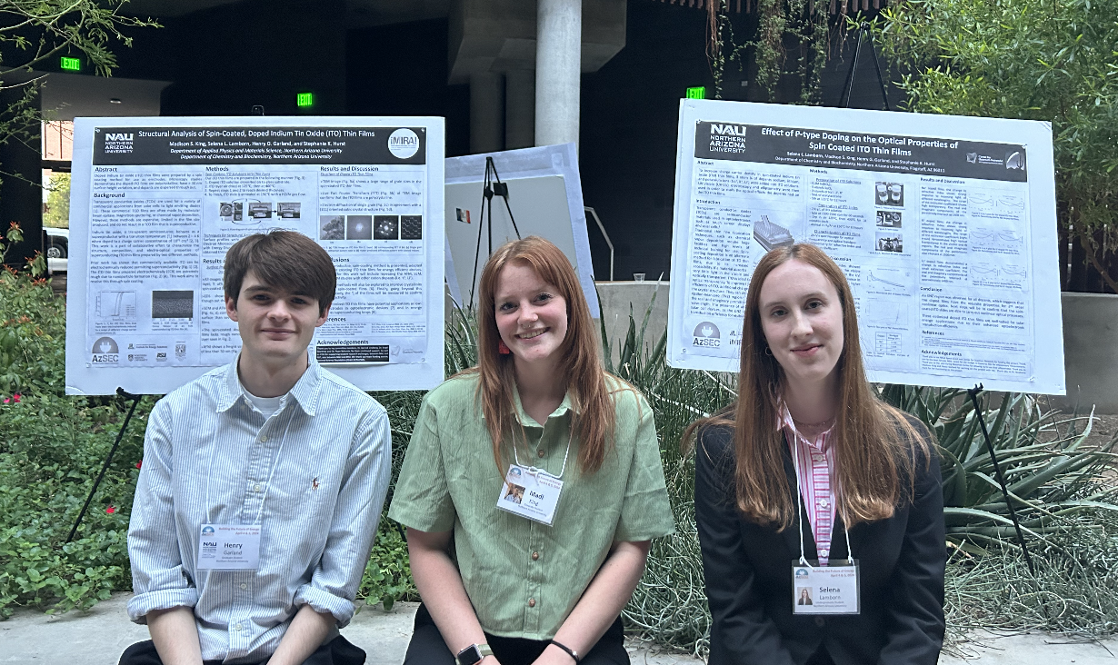
Acknowledgements
NASA Space Grant and the Center for Quantum Networks for funding on this project
Jean Shuler mini-grant for supporting travel to ASU for ellipsometry measurements
ASU Eyring Materials Center for ellipsometer use
Thank you to my laboratory partners, Madison King and Henry Garland for working with me on this project
Thank you to Dr. Stephanie Hurst for her mentorship on this project.
9

Slide 10
Thank You!
10

Slide 11
References
(1) Magazine, E. Quantum Computing and Data Storage: Navigating the Challenges Ahead. Medium. https://medium.com/@etirismagazine/quantum-computing-and-data-storage-navigating-the-challenges-ahead-ceb05d1784f4 (accessed 2024-04-04).
(2) Kuen Yao, L.; Yang, Y.; Zhao, D.; Liu, X.; Qiu, J. Tunable Optical Nonlinearity of Indium Tin Oxide for Optical Switching in Epsilon-near-Zero Region. Nanophotonics 2022, 11. https://doi.org/10.1515/nanoph-2022-0306.
(3) Batson, E.; Colangelo, M.; Simonaitis, J.; Gebremeskel, E.; Medeiros, O.; Saravanapavanantham, M.; Bulovic, V.; Keathley, P. D.; Berggren, K. K. Reduced ITO for Transparent Superconducting Electronics. Supercond. Sci. Technol. 2023, 36 (5), 055009. https://doi.org/10.1088/1361-6668/acc280.
(4) Mostaço-Guidolin, L.; Rosin, N.; Hackett, T.-L. Imaging Collagen in Scar Tissue: Developments in Second Harmonic Generation Microscopy for Biomedical Applications. Int. J. Mol. Sci. 2017, 18, 1772. https://doi.org/10.3390/ijms18081772.
(5) Labelle, A. J.; Bonifazi, M.; Tian, Y.; Wong, C.; Hoogland, S.; Favraud, G.; Walters, G.; Sutherland, B.; Liu, M.; Li, J.; Zhang, X.; Kelley, S. O.; Sargent, E. H.; Fratalocchi, A. Broadband Epsilon-near-Zero Reflectors Enhance the Quantum Efficiency of Thin Solar Cells at Visible and Infrared Wavelengths. ACS Appl. Mater. Interfaces 2017, 9, 5556–5565. https://doi.org/10.1021/acsami.6b13713.
(6) Ellipsometry FAQ. J.A. Woollam. https://www.jawoollam.com/resources/ellipsometry-faq (accessed 2024-04-08)
11

